Slide 1
Cloud Based Managed Security Service

Slide 2
Meet our team
Parthkumar Patel
Sharif Ahmed
Project Manager
Project Advisor
Nikhilkumar Dobariya
Varun Gulati
Manpreet Kaur
Haroon John

Slide 3
Agenda
Project Background
Project Objective
Benefits
Effective Project Solution
Project Demonstration
Bibliography

Slide 4
Project Background
Khupragenics, a start-up in Toronto's MaRS Discovery District, specializing in utilizing genomic sequencing to find disease-causing mutations in infants. This is very sensitive information is shared with medical experts and parents so that possibly life-saving clinical intervention can be provided. We are certain that our recommended solution will assist Khupragenics in establishing a strong foundation of trust with its clients, assuring the company's long-term success.

Slide 5
DATA BREACHES
(Seh, A. H., Zarour, M., Alenezi, M., Sarkar, A. K., Agrawal, A., Kumar, R., & Ahmad Khan, R. 2020, May 13).

Slide 6
Project objective
The primary purpose of this project is to illustrate our strategy for increasing client trust in Khupragenics' capacity to handle sensitive information safely. As a firm focused on employing genomic sequencing to uncover disease-causing mutations in infants, patient data security is critical. We want to offer Khupragenics with the necessary tools and resources to adequately preserve sensitive material and guarantee that medical professionals and parents can trust the firm with their most precious information through our recommended techniques.

Slide 7
The Business Benefits of our Project
Ultimately, our solution will give Khupragenics’ with a strong and dependable security framework, increasing consumer trust in the company's capacity to safeguard sensitive information.
Increased Customer Confidence:
By creating an effective and sustainable way to improve the security of sensitive information, Khupragenics will be able to boost customer trust in the company's capacity to secure their sensitive data.
Employee Training and Awareness Programs:
The implementation of employee training and awareness programs will guarantee that all workers are equipped with the knowledge and skills necessary to handle sensitive information responsibly.
Improved Data Security:
implementing better data protection measures and conducting frequent reviews of the company's systems and procedures, data security will be improved, and the danger of data breaches will be reduced.

Slide 8
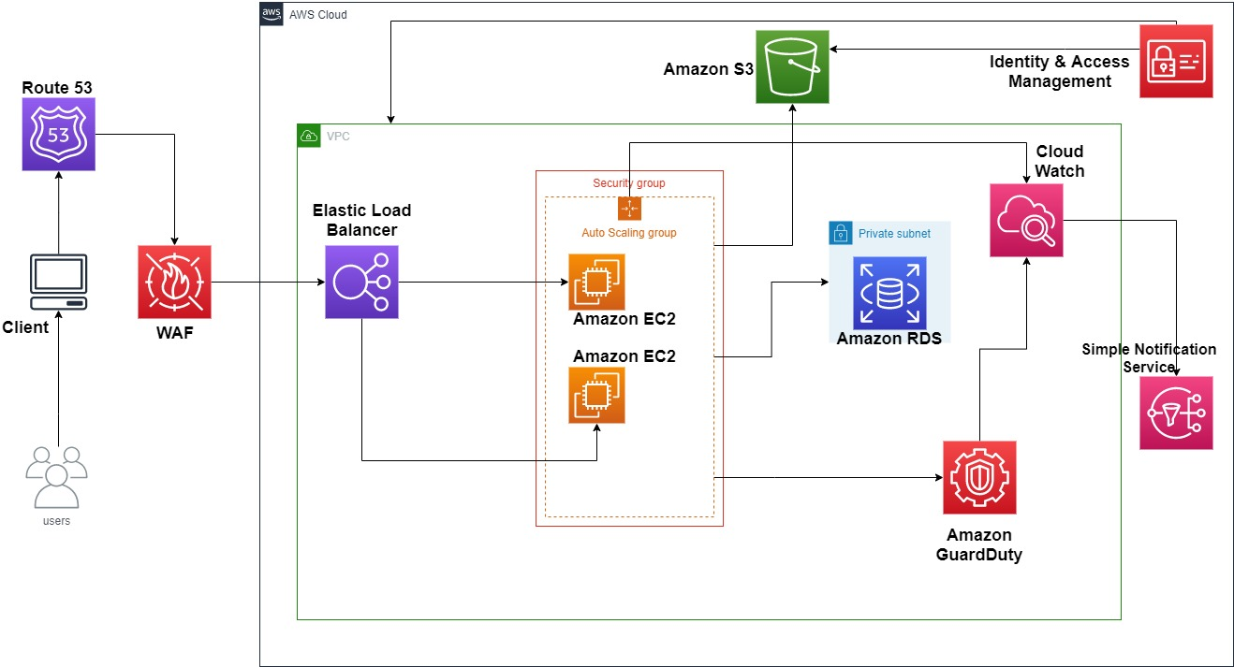
Effective Project Solution

Slide 9
Project Demonstration

Slide 10
Bibliography
Seh, A. H., Zarour, M., Alenezi, M., Sarkar, A. K., Agrawal, A., Kumar, R., & Ahmad Khan, R. (2020, May 13). Healthcare data breaches: Insights and implications. MDPI. Retrieved February 27, 2023, from
https://www.mdpi.com/715382 .
VENKATESH, L. (2021, June 23). AWS Series: Reference Architecture #1 — Web Application Type 1. Nerd for Tech./
aws-series-reference-architecture-1-web-application-type-1-2817c8dc09b .
Good practices in community engagement and readiness - NRCAN. (n.d.). Retrieved March 19, 2023, from
https://naturalresources.canada.ca/sites/www.nrcan.gc.ca/files/mineralsmetals/files/pdf/rmd-rrm/GoodPractices2ed_En.pdf

Slide 11
Bibliography
Guidelines for media sanitization - NIST. (n.d.). From
https://nvlpubs.nist.gov/nistpubs/SpecialPublications/NIST.SP.800-88r1.pdf
Patient access information for individuals: Get it, check it, use it! HealthIT.gov. (2020, January 31). Retrieved March 20, 2023, from How will the MSS organization tailor the security plan to the customer's specific needs.
https://www.healthit.gov/topic/patient-access-information-individuals-get-it-check-it-use-it
In-depth guide to Managed Security Services in 2023.AIMultiple. (n.d.). Retrieved March 20, 2023, from
https://research.aimultiple.com/managed-security-services/
Chapter 3-Security Policy: Development and implementation, from safeguarding your technology, NCES publication 98-297 (National Center for Education Statistics). (n.d.). Retrieved March 20, 2023, from
https://nces.ed.gov/pubs98/safetech/chapter3.asp

Slide 12
Thank You

Slide 13
Questions & Answers

